Slide 1
DNA Restriction and mechanism

Slide 2
The Nobel Prize in Physiology or Medicine 1978
http://nobelprize.org/nobel_prizes/medicine/laureates/1978/#

Slide 3
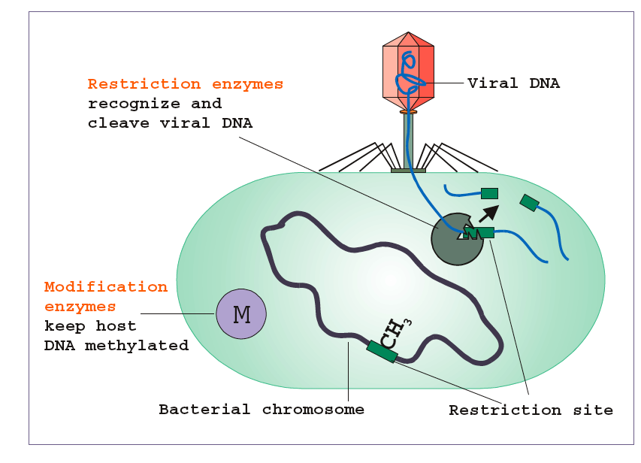
Let me protect my self.

Slide 4
Distinguishing features of different types of restriction enzymes
Type I systems: have so far only been found in members of the family Enterobacteriaceae, with the exception of an early report of a member in Haemophilus influenzae
MICROBIOLOGICAL REVIEWS, June 1993, p. 434-450

Slide 5
Example
RM I: strains (K-12 and B) of E. coli
RM II: BcgI and BplI, NaeI, NgoMIV, Eco57I, Bpu10I and BslI
RM IIS: FokI
RM III: EcoP15

Slide 6
Derivation of the EcoRI name
Abbreviation | Meaning | Description
E | Escherichia | genus
co | coli | species
R | RY13 | strain
I | First identified | order of identification in the bacterium

Slide 7
Specificities of type I restriction enzymes
MICROBIOLOGICAL REVIEWS, June 1993, p. 434-450

Slide 8
Genetic organization of hsd gene
hsdS: specificity determinant for hsdM and hsdR
hsdR: Host Restriction
hsdM: host modification; DNA methylase M
MICROBIOLOGICAL REVIEWS, June 1993, p. 434-450

Slide 9
Eu and pro-karyotes methylation
The mammalian enzymes methylate the cytosine in mainly CG sequences to 5-methylcytosine (5-meC), but they do it efficiently only if the cytosine in the opposite strand already bears a methyl residue. The result is that CG sequences that are methylated perpetuate their methylated state following DNA replication whereas unmethylated CG sequences normally remain nonmethylated.
Most prokaryotic DNA methylases behave quite differently. They show no marked preference for hemimethylated over nonmethylated DNA and therefore have the properties expected for the postulated de novo eukaryotic enzyme. (RM I)
MICROBIOLOGICAL REVIEWS, June 1993, p. 434-450

Slide 10
RE and their evolutionary history
Isoschizomers: Endonucleases from different bacterial species that recognize the same sequence and cut it at the same position, such as BsuRI and NgoPII, are very different.
It can be concluded that endonucleases have not evolved from a single primitive precursor and have acquired different sequence specificities by mutating the TRD (target recognition domain). They must be of different evolutionary origin.

Slide 11
Methylation of nucleotides

Slide 12
Breakthrough in analysis of DNA methylation
5-methylcytosine was oxidised efficiently by a reaction mixture containing an osmium compound, while cytosine was oxidised only weakly.
5-Methylcytosine appears in genomic DNA and plays a key role in epigenetic events, which affect the control of gene expression and cell differentiation
A Okamoto, K Tainaka and T Kamei, Org. Biomol. Chem., 2006

Slide 13
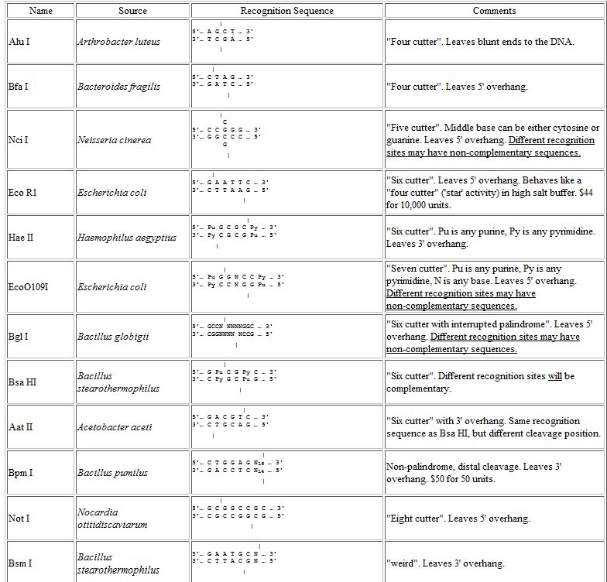
Examples of different restriction enzymes
http://www.mikeblaber.org/oldwine/bch5425/lect03/lect03.htm

Slide 14
Examples of phage antirestriction mechanisms

Slide 15
RESTRICTION SYSTEMS SPECIFIC FOR MODIFIED DNA DpnI and DpnII
dpnI: The first restriction enzyme that was shown to require a methylated substrate was DpnI from Streptococcus pneumoniae, which cleaves the sequence GATC only if the A is methylated.
dpnII: Other strains of S. pneumoniae have the complementary specificity and produce DpnII, which recognizes and cleaves the same sequence only if it is not methylated.

Slide 16
Evolutionary interactions between T-even phages and their hosts

Slide 17
Let me protect my self again..

Slide 18
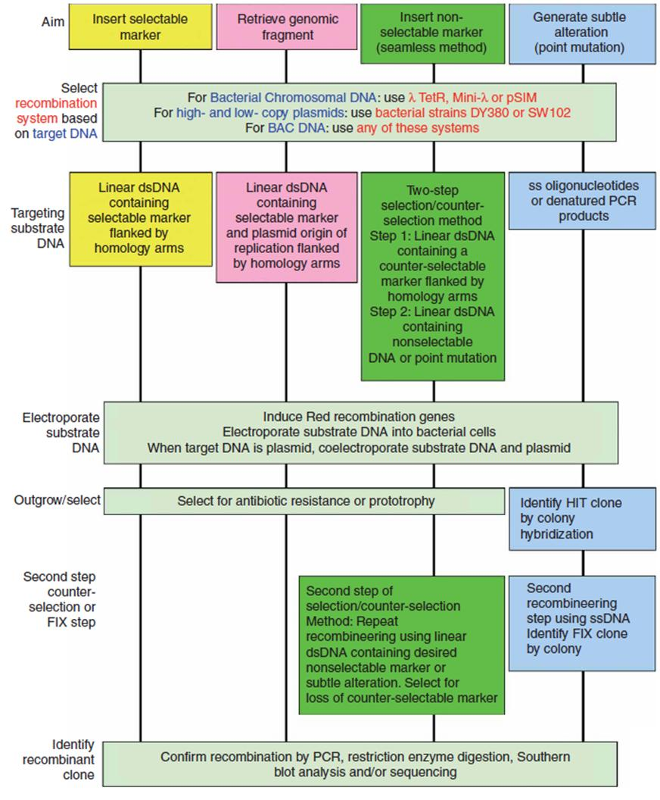
Write 200 words about the road map

Slide 19
?
Question

